Slide 1
A Cross Asset Portfolio Optimization Framework Based on Crypto Mental Synthesis
QUANTITATIVE STUDY BASED ON DAILY DATA FROM 2015 TO 2025
Group 1: Qiu Yusen | Huang Yukong | Li Jintao | Shan Zhengxu
Date：20260401

Slide 2
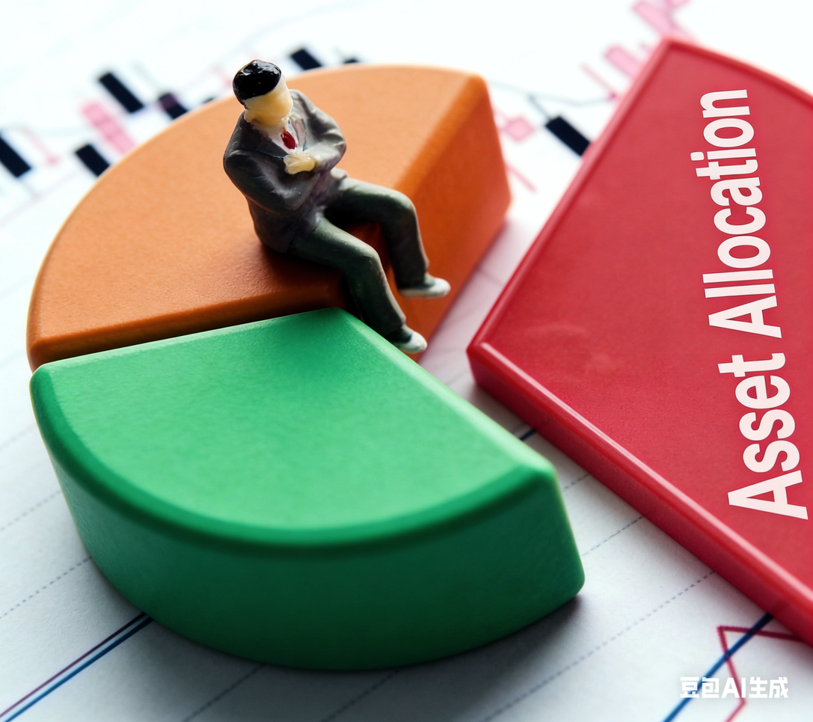
CONTENTS
01.Background
02.Data analysis
03.Reserch results
04.Summary

Slide 3
01 Background
Background significance of the topic

Slide 4

background
Non-ferrous metals have both anti-inflation attributes and financial investment attributes.
Cryptocurrency has become a mainstream alternative investment target and cross-asset allocation value are current investment hotspots.
it is urgently necessary to construct optimal allocation plans that suit different risk preferences.

Slide 5
Objectives and methods
Research Objectives
Research Methods
01
Pearson correlation
Mutual Information regression
01
Quantitatively measure the linkage between cryptocurrencies and non-ferrous metals.
02
VIX-based hedging analysis
TNX stratification
02
Analyze the performance, hedging properties & cyclical characteristics of two types of assets.
03
Construct the optimal cross-asset investment portfolio of cryptocurrency and non-ferrous metals.
CAPM regression
03

Slide 6
02 Analysis of data
Background significance of the topic

Slide 7
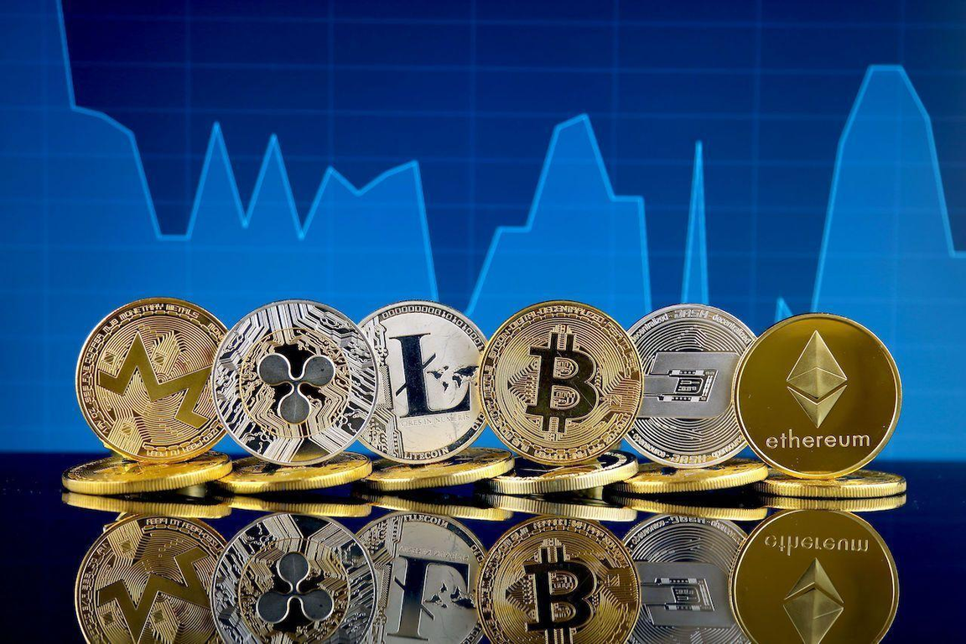

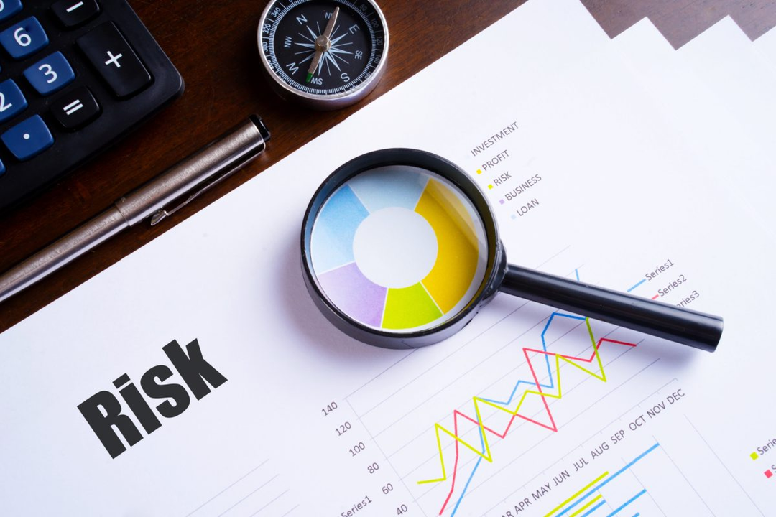
Data
Cryptocurrency
BTC、ETH、USDT
Non-ferrous metals
Gold 、Silver 、Copper
Macroeconomic Risk Indicators
VIX、DXY、TNX
Data source: Yahoo Finance

Slide 8
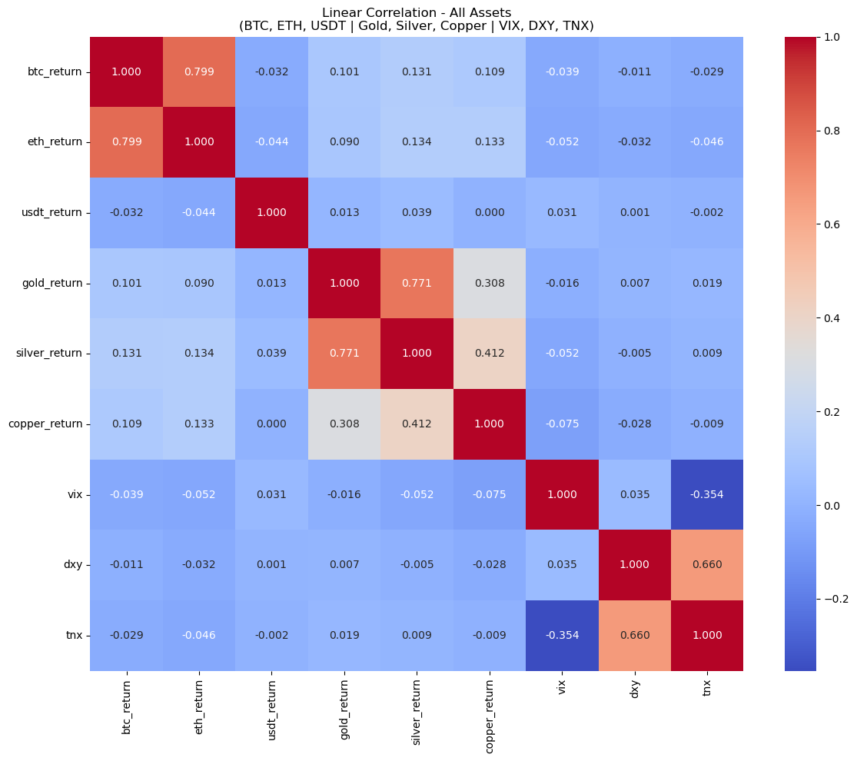
Linear correlation analysis
Use the Pearson correlation coefficient to measure the degree of linear linkage between assets.
No linear correlation between assets from different categories.

Slide 9
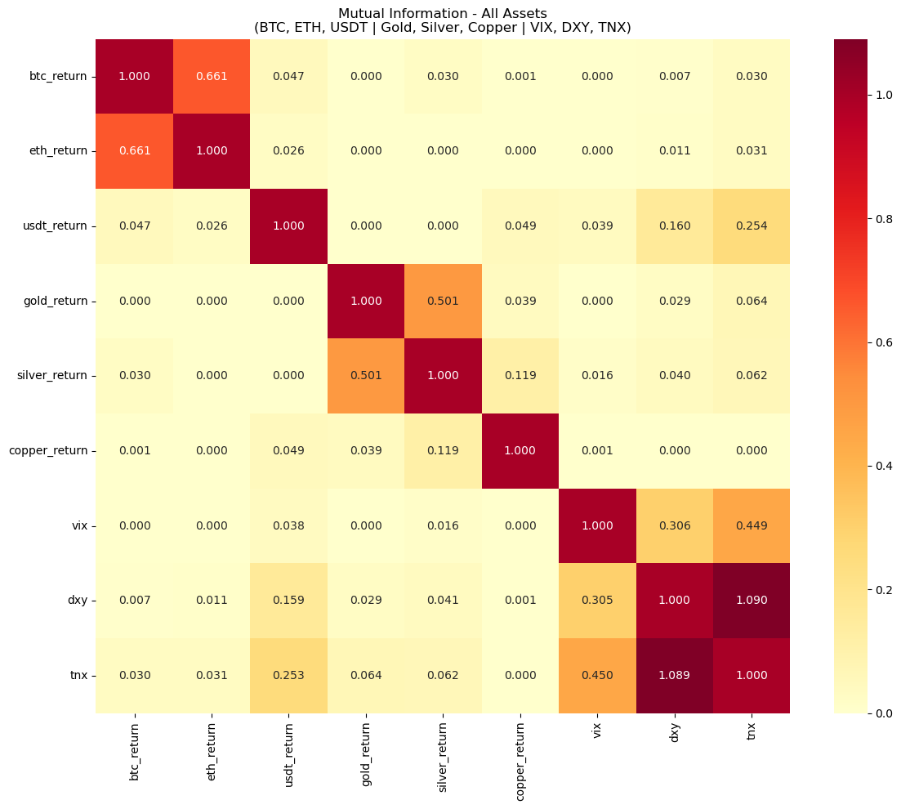
Nonlinear correlation analysis
Mutual information matrix, compensating for the limitations of the linear correlation coefficient.
No nonlinear correlation between assets from different categories.

Slide 10
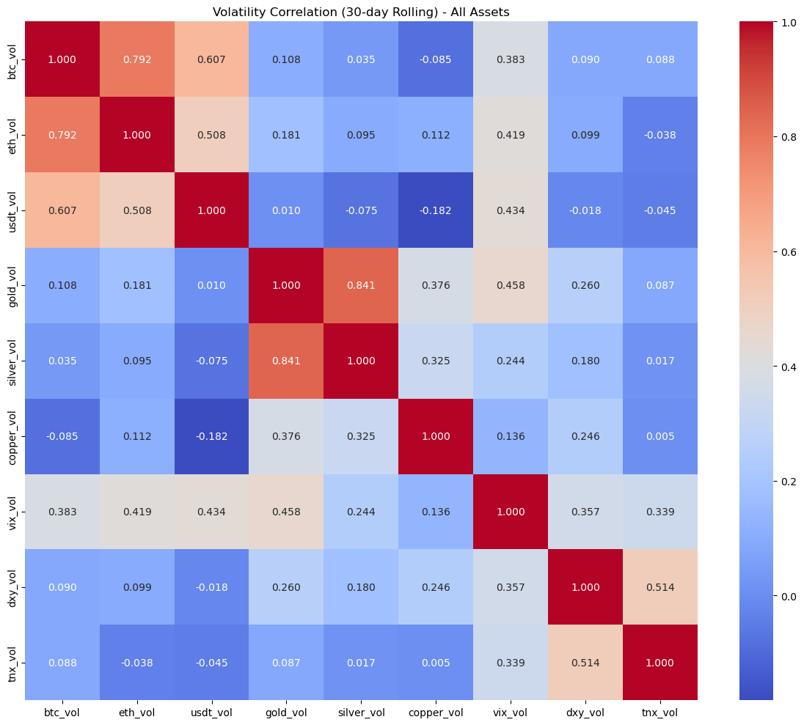
Volatility correlation analysis
Show the risk linkage patterns between various assets and macro indicators.
No volatility correlation between assets from different categories.

Slide 11
Discussion
So far, we did not identify any static correlation among the assets.
Thus, we try to compare different markets and capture rolling correlation and price trends.

Slide 12
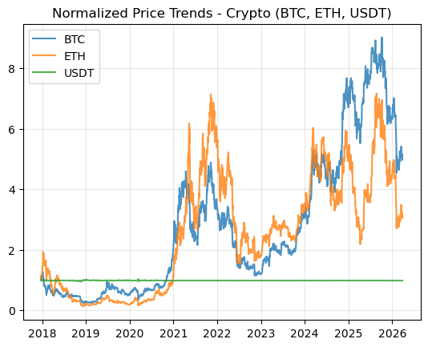
price trends
There is a significant time-varying dynamic correlation between cryptocurrencies.

Slide 13
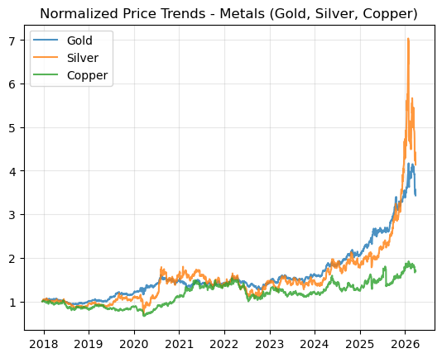
price trends
There are significant time-varying price dynamic correlations among various non-ferrous metals.

Slide 14
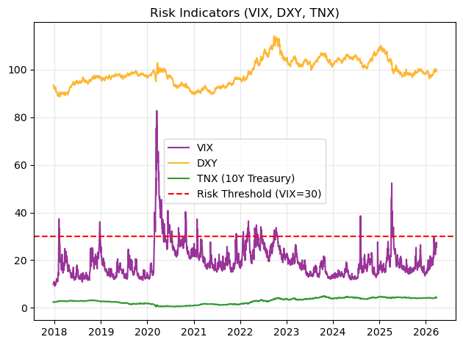
price trends
There is no dynamic correlation among various risk indices.

Slide 15
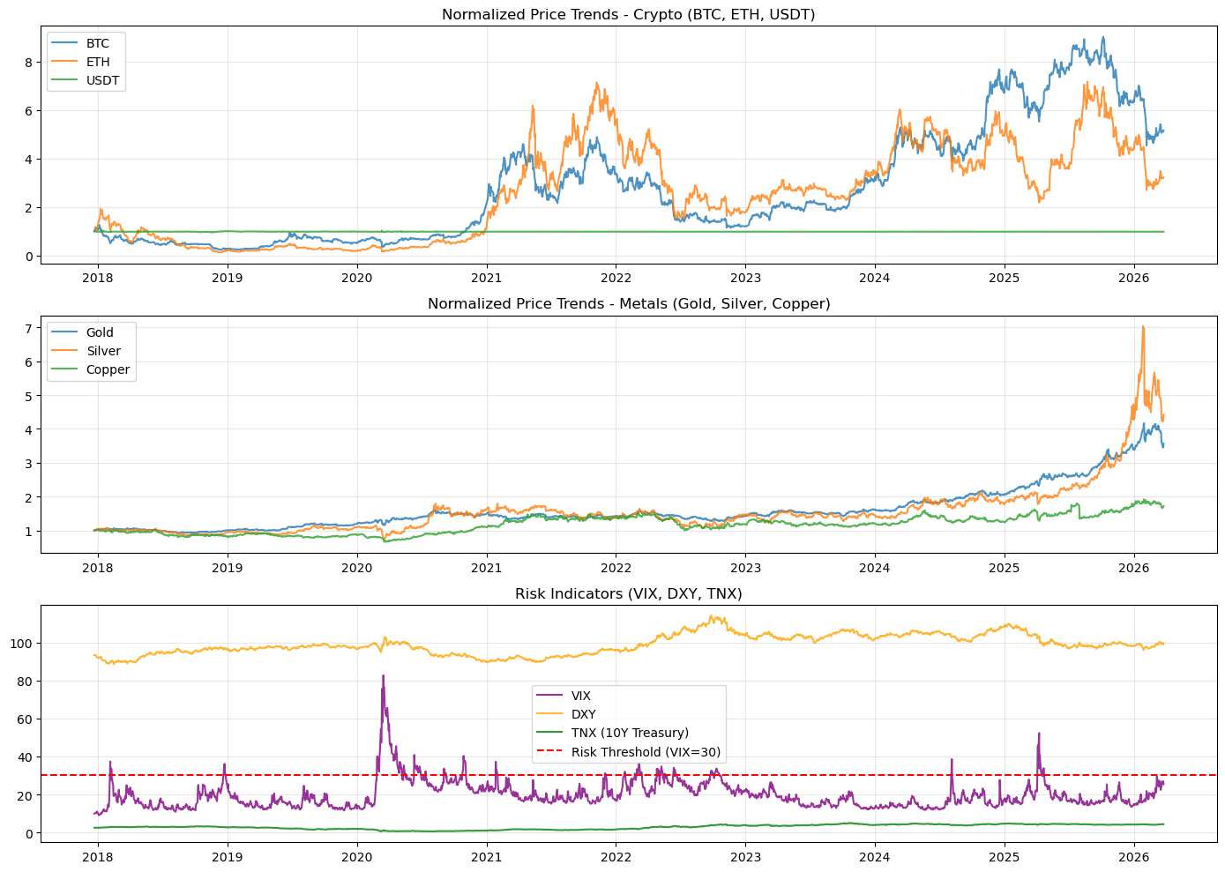
price trends
By normalizing prices and macro risk indicators, the differences in trends between cryptocurrencies, non-ferrous metals, and the global macro environment from 2018 to 2026 are intuitively compared.

Slide 16
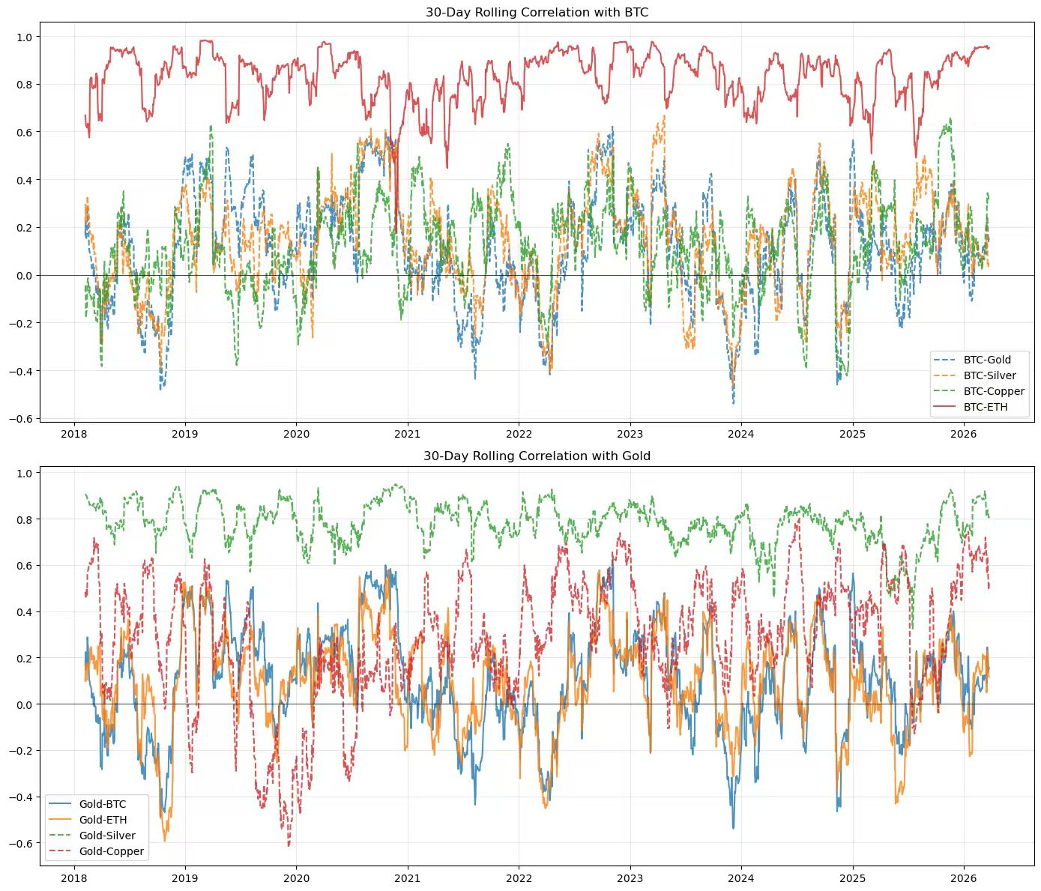
rolling correlation
Dynamically display the correlated changes of Bitcoin (BTC), gold (Gold), and other assets.

Slide 17
Discussion
Result A
The linear and nonlinear correlation between cryptocurrencies and non-ferrous metals has long been close to 0.
Result B
Result C
Cryptocurrencies have a low correlation with non-ferrous metals and have excellent risk diversification value.
There is no dynamic correlation between cryptocurrency and non-ferrous metals.

Slide 18
03 Analysis result
Background significance of the topic

Slide 19
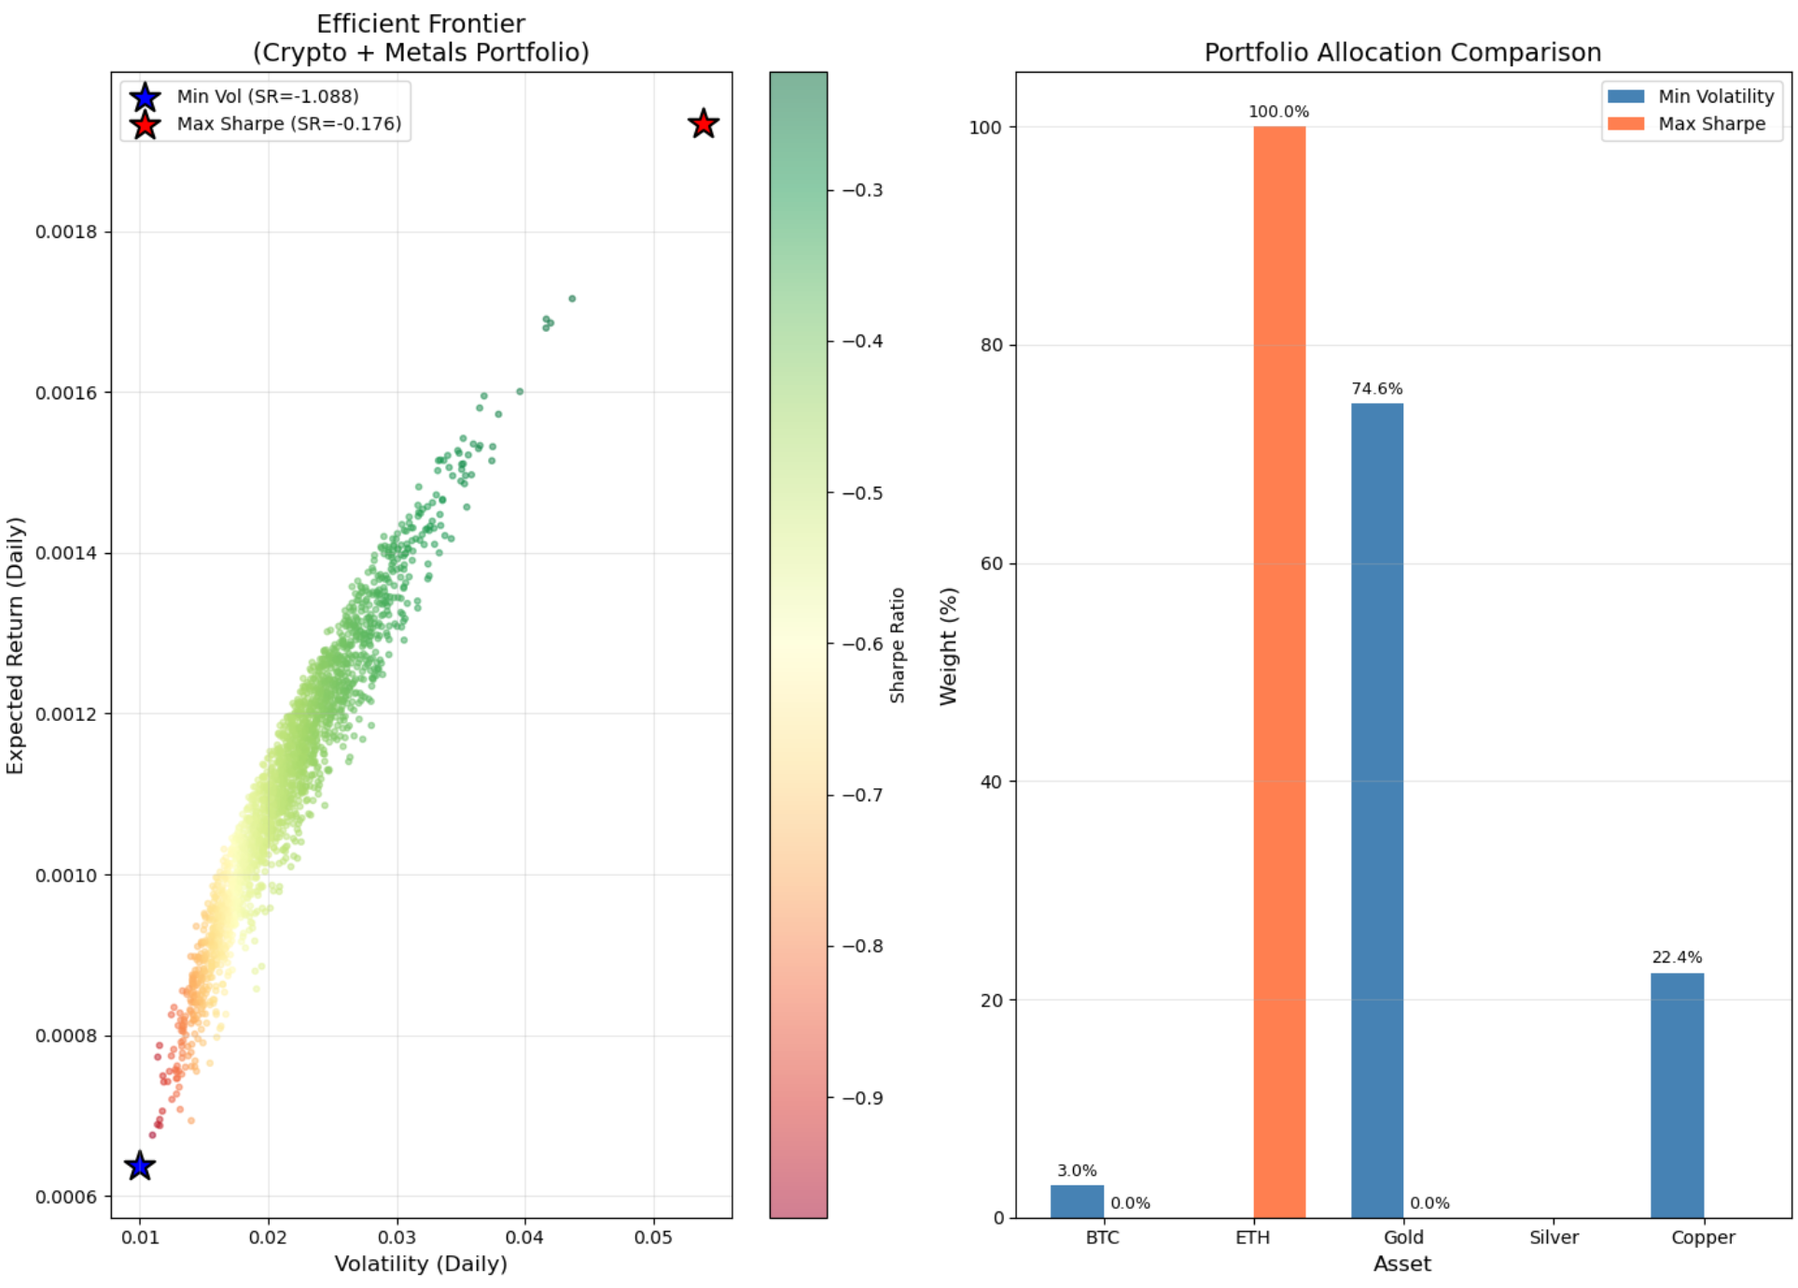
Portfolio Optimization Framework
Applies the CAPM to price crypto and metal asset. portfolio as benchmark, estimating each asset's beta and alpha.
So easy
We need
Portfolio optimization is then conducted: minimizing volatility and maximizing the Sharpe ratio.

Slide 20
04 Summary
Background significance of the topic

Slide 21
Implications
Implication1
Cryptocurrencies can significantly enhance portfolio returns in a low interest rate and low panic environment, but positions need to be controlled to manage extreme risks.
Implication 2
Gold is a core hedge against market panic and rising interest rates, suitable to serve as the base position in a portfolio.
Implication 3
Cross-asset allocation (cryptocurrencies and non-ferrous metals) can effectively diversify the systemic risk of a single asset category, achieving a balance between risk and return.

Slide 22
Thank you！

